Slide 1

LPG leakage detection for disaster struck areas

Slide 2
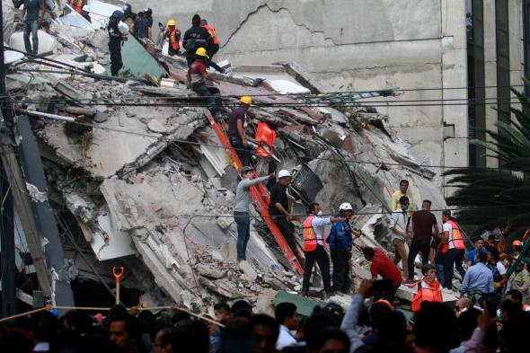
Concept
Product Enabled Service
LPG Gas Detection in disaster struck areas
In the automatic mode, the coordinates of the location is sent to the Emergency response team who are surveying the area.
In another alternative mode, the data is collected and stored in memory. It will be viewed when required and sent to the cloud.

Slide 3





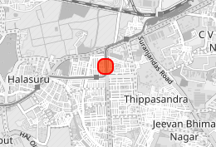




Architecture
LPG gas detected!!!
Lat:12.98.893
Lon: 77.640313
IBM Watson IoT
Platform
MQTT
The latitude, longitude along with whether LPG gas is detected or not is sent to the IBM Watson IoT Platform via the mobile network.
Gas Sensor

